Slide 1
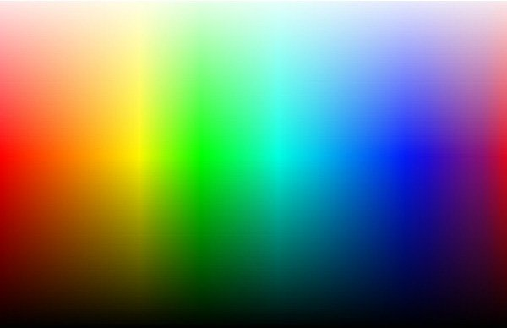
Advanced higher Graphic communication
DTP Printing Technologies Colour Systems

Slide 2
Learning intentions & success criteria
Learning Intentions
Gain an understanding of different colour systems used in AH graphic communication.
Success Criteria
Describe and explain the main features of each colour space.
Compare RGB, CMYK and Pantone colour spaces.

Slide 3
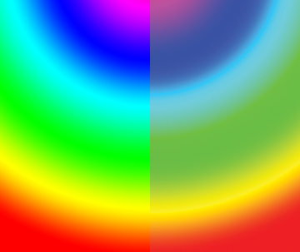
Additive and subtractive colour systems
ADDITIVE colours use transmitted light, the colours appear much brighter and create a larger visible spectrum, producing millions of colours on a screen.
e.g. RGB
SUBTRACTIVE colours use reflected light, so they appear muted in contrast.
e.g. CMYK

Slide 4
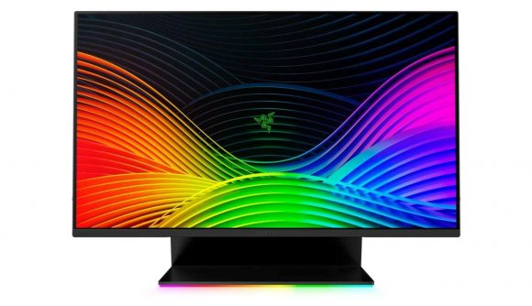
RGB (red, green & blue)
Where is this standard applied?
The RGB colour model is an additive colour model in which red, green and blue are added together in various ways o reproduce a broad array of colours.
The name of the model comes from the initials of the three additive primary colours, red, green and blue.
The main purpose of the RGB colour model is for the sensing, representation and display of images in electronic systems, such as televisions and computers, though it has also been used in conventional photography.

Slide 5
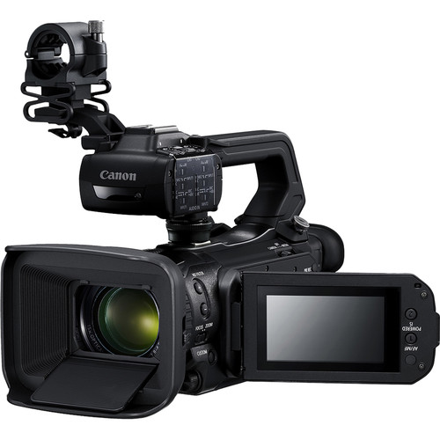
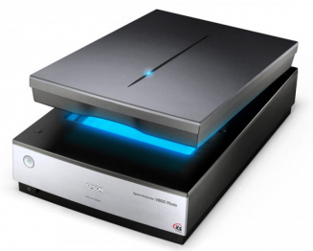
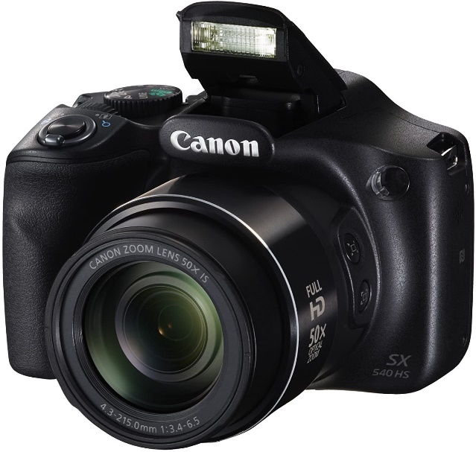
RBG: What are it’s special features?
Typical RGB input devices are colour TV and video cameras, image scanners, video games and digital cameras.

Slide 6
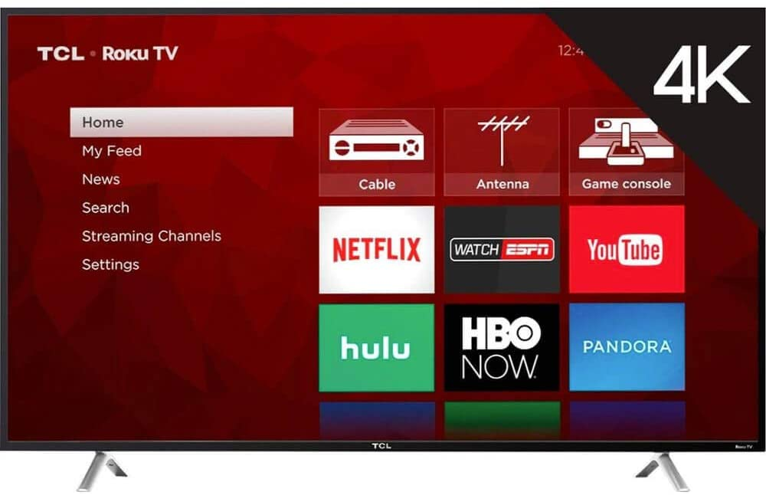
RBG: What are it’s special features?
Typical RGB output devices are TV sets of various technologies (CRT, LCD, Plasma, OLED, etc.), computer and mobile phone displays, video projectors, multicolour LED displays.

Slide 7
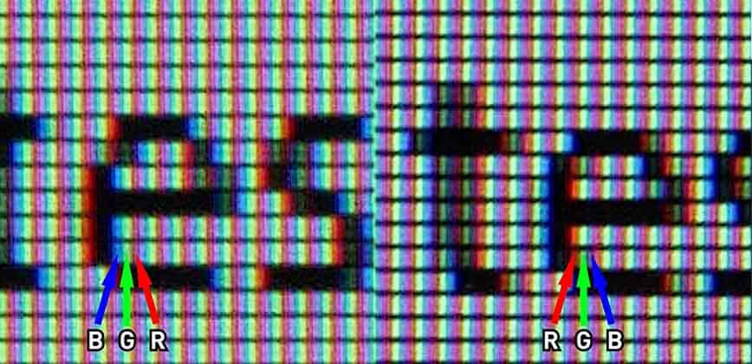
RBG: What are it’s special features?
Each pixel on the screen is built by driving three small and very close but still separated RGB light sources. At common viewing distance, the separate sources are indistinguishable, which tricks the eye to see a given solid colour.
All the pixels together arranged in the rectangular screen surface conforms the colour image.

Slide 8
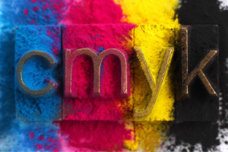
Cmyk (cyan, magenta, yellow, black (Key colour))
Where is this standard applied?
The CMYK colour model is a subtractive colour model, used in coloured printing and is also used to describe the printing process itself. CMYK refers to the four inks used in some colour printing:
Cyan
Magenta
Yellow
Black.

Slide 9
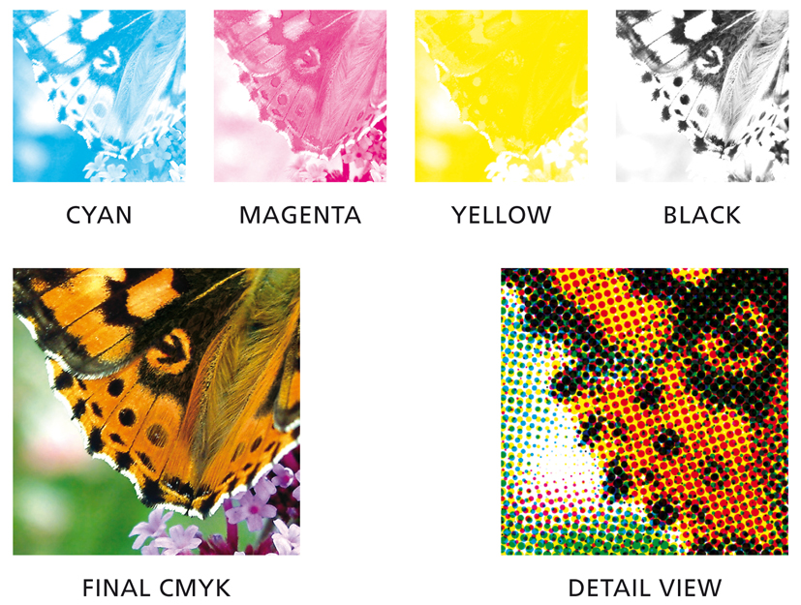
CMYK What are it’s special features?
CMYK colour space, traditionally, when the final proof is agreed the designer will make up “Colour Separations”.
These split the image up into its constituent colours for four-colour-printing.

Slide 10
CMYK What are it’s special features?
There will be one separation each for Cyan (Blue), Magenta (Red), Yellow and Key (Black), known as CMYK colour.
In theory, there need only be three colours in printing because every colour is made up from the three primary colours, red, yellow and blue.
As a result of the impurities of printing ink and the reflective qualities of paper, the three colours mixed would make up a muddy brown, so a black separation is added to give definition.

Slide 11
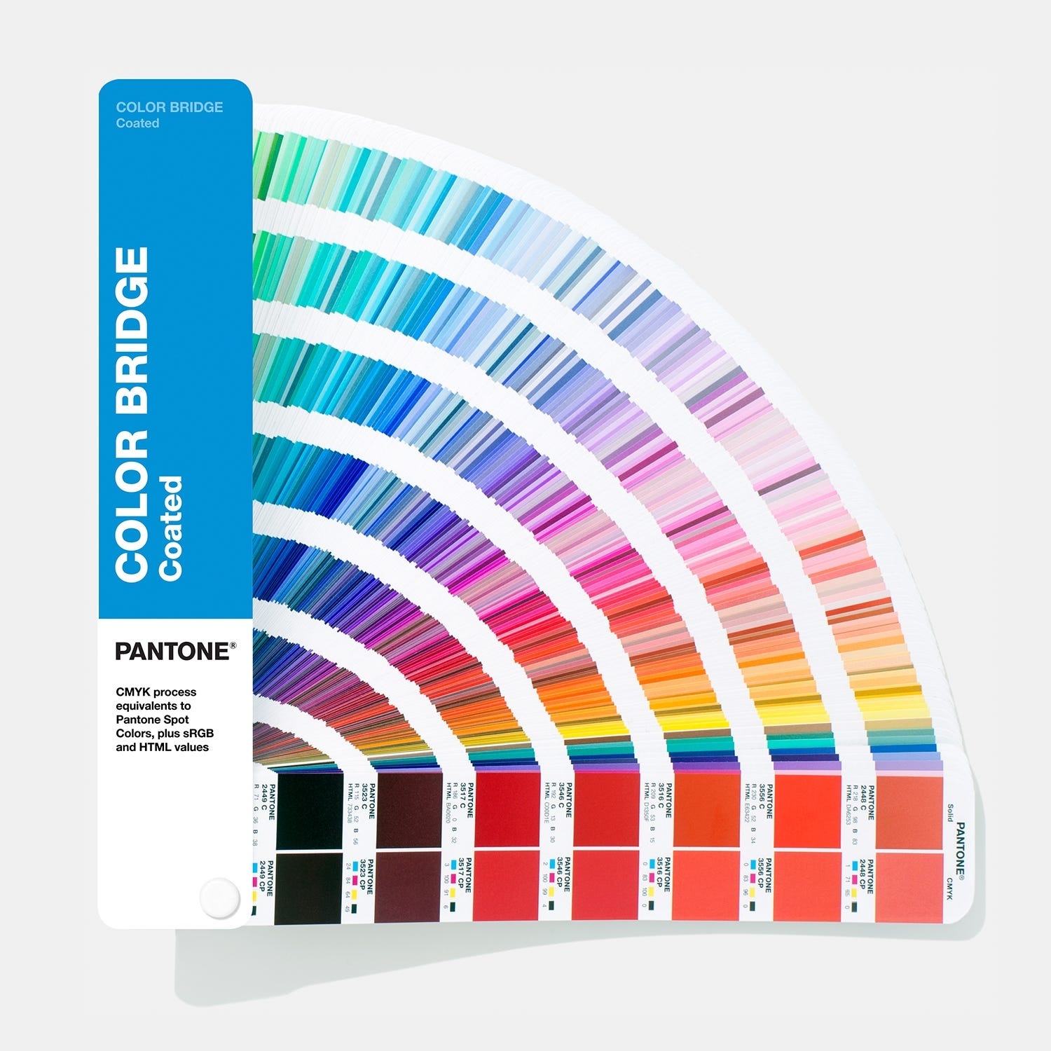
pantone
Where is this standard applied?
The Pantone Matching System (PMS) is a proprietary colour space used in a variety of industries, primarily printing, though sometimes in the manufacture of coloured paint, fabric and plastics.
The Pantone colour guides have been widely adopted and are used by artists, designers, printers, manufacturers, marketers and clients in all industries worldwide for accurate colour identification, design specification, quality control and communication.

Slide 12
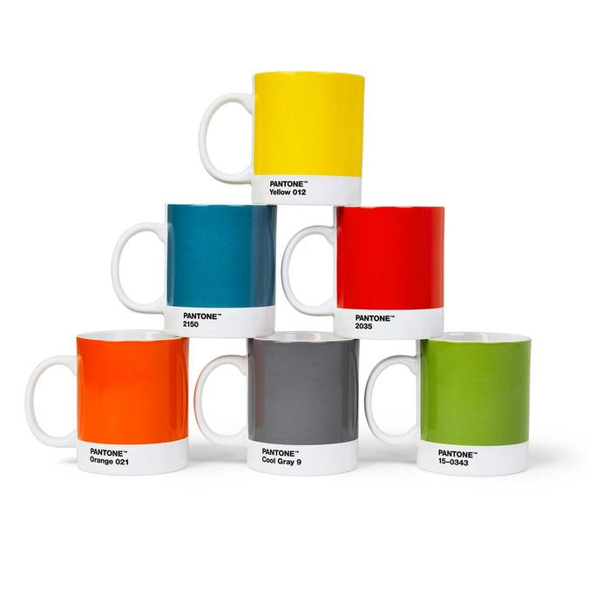
Pantone What are it’s special features?
The Pantone ® name is known worldwide as the standard language for colour communication from designer to manufacturer to retailer to customer.
The Pantone Colour Matching System is largely a standardised colour reproduction system. By standardising the colours, different manufacturers in different locations can all refer to the Pantone system to make sure colours match without contact with one another.
Pantone can be used for both CMYK and RGB colour spaces. Colour variance also occurs based on the paper stock used (coated, matte or uncoated).

Slide 13
Colour space and detail
You will be required to include your chosen colour space and colour details as part of your project’s CVMG section.
Your colour space and detail can be found in PagePlus under the “Colour” tab on the right hand side.
In this example, the information is:
Colour Space: CMYK
Colour Detail: C:46 M:75 Y:84 K:35

